Slide 1


SMOKE AND GAS LEAKAGE DETECTOR
Name-Aman Singh
Class- B-Tech Electrical

Slide 2
INTRODUCTION
A smoke detector is a device that senses smoke, typically as an indicator of fire. Commercial smoke detectors issue a signal to a fire alarm control panel as part of a fire alarm system, while household smoke detectors, also known as smoke alarms, generally issue an audible or visual alarm from the detector itself or several detectors if there are multiple smoke detectors interlinked.
In case of fire at home/office the internal parts of the premises gets filled with smoke. This smoke layer progressively becomes so thick that it lowers the visibility considerably. We can use this fact to construct our simple smoke detector alarm that can notify the residents in around the premises about the fire breakout.
The Smoke Detector Alarm is very compact as it doesn’t employs the costly smoke detecting sensors. It has pair of infrared sensors which are continuously monitoring the visibility in the premises where they are attached. In case a fire erupts, smoke gets generated and spreads in and around the premises. Once this smoke reaches the smoke.
The principle behind working of this project is of the opaqueness property of smoke. In case when there is no smoke the infrared sensors are continuously in view of each other. Once smoke comes in the view, the sensor signal is obstructed and the output of the sensor changes. This change is sensed by the system to ring an alarm to notify the residents in and around the premises about the fire breakout.

Slide 3
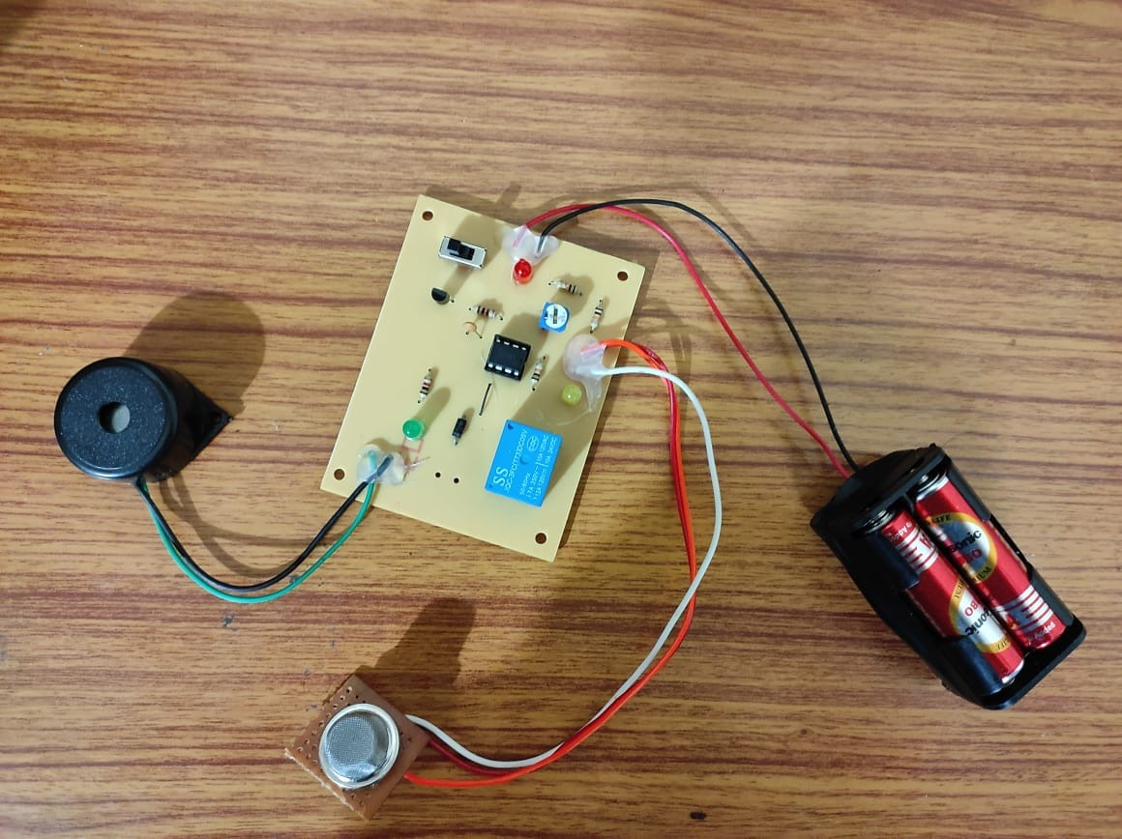
PROJECT IMAGE

Slide 4
COMPONENTS
S. No. | Components used
1. | LM358
2. | Gas Sensor
3. | Buzzer
4. | Connecting Wires
5. | led
6. | Power supply

Slide 5
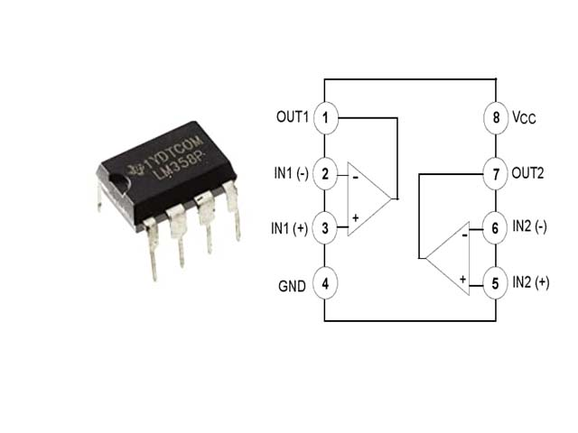
DESCRIPTION OF COMPONENTS
1]LM358:- The LM358 contains two independent high gain operational amplifiers, low power, dual channel op-amp, high gain with internal frequency compensation. Single power supply will be required to operate both op-amps in LM358. We can also use a split power supply. The device has low power supply voltage. LM358 IC can also be used as transducer standard operational amplifier, and it is suitable for our needs. It can handle voltage from 3V to 32V DC supply and current up to 20mA per channel.
It consists of 8 pins which contains two operational amplifiers. Operational amplifier has two inputs and one output in one independent LM358. Inputs are at pin 2 (negative pin) and 3 (positive pin), positive pin is used for positive feedback and negative pin is used for negative feedback. In ideal condition when no feedback is applied, gain of the operational amplifier should be infinite. When voltage at pin 2 is more than voltage at pin 3 it will raise the output towards the positive maximum voltage and a slight increase at negative pin compared to positive pin will lower the output towards the negative maximum. This feature of operational amplifier makes it suitable for the purpose of level detection.

Slide 6
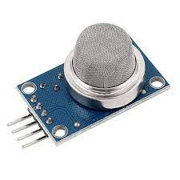
2]
Gas Sensor:- A gas sensor is a device that detects the presence of gases in an area, often as part of a safety system. A gas detector can sound an alarm to operators in the area where the leak is occurring, giving them the opportunity to leave. This type of device is important because there are many gases that can be harmful to organic life, such as humans or animals.
Gas detectors can be used to detect combustible ,flammable and toxic gases, and oxygen depletion. This type of device is used widely in industry and can be found in locations, such as on oil rigs, to monitor manufacturing processes and emerging technologies such as photovolic They may be used in firefighting Gas leak detection is the process of identifying potentially hazardous by sensor.). More recently, infrared imaging sensors have come into use. All of these sensors are used for a wide range of applications and can be found in industrial plants, refineries, pharmaceutical manufacturing, fumigation facilities, paper pulp mills, aircraft and shipbuilding facilities, hazmat operations, waste-water treatment facilities, vehicles, indoor air quality testing and homes.

Slide 7

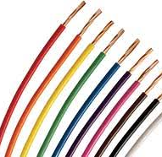
3].Buzzer:- A buzzer or beeper is an audio signalling device, which may be mechanical, electromechanical, or piezoelectric (piezo for short). Typical uses of buzzers and beepers include alarm devices, timers, and confirmation of user input such as a mouse click or keystroke.
4]. Connecting wires:- Connecting wires allows an electrical current to travel from one point on a circuit to another because electricity needs a medium through which it can move. Most of the connecting wires are made up of copper or aluminium.

Slide 8
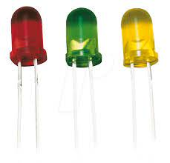
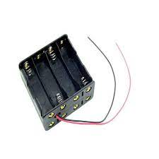
5].LED:- Made popular by their efficiency, range of color, and long lifespan, LED lights are ideal for numerous applications including night lighting, art lighting, and outdoor lighting. These lights are also commonly used in electronics and automotive industries, and for signage, along with many other uses.
6]. Power Supply:-In this project the power supply required is very much precession and also requires different level of power supply. Basically, the power supply used for the transmitter and receiver is arranged from a battery. Along with the battery the power supply requirement is +12 Volt and +5Volt.

Slide 9
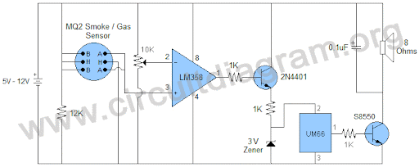
WORKING PRINCIPLE
The project includes a small gas sensor board which is interfaced to other board with LM358 on it.
The gas sensor senses the smoke and sends the signal to LM358 which will compare the signal voltage with a reference one.
Based on a proper smoke signal, the IC will switch on the transistor which in turn will switch on the buzzer via relay

Slide 10
APPLICATIONS
Smoke detector is an electronic fire-protection device that automatically senses the presence of smoke, as a key indication of fire, and sounds a warning to building occupants.
Commercial and industrial smoke detectors issue a signal to a fire alarm control panel as part of a building's central fire alarm system.
It control fire from spreading by informing the chief executive officer for security and prevent financial and life losses

Slide 11
ADVANTAGES
Smart smoke detectors use the latest technology to detect the presence of smoke using photoelectric smoke-sensing technology. Their ultra sensitivity prevents false alarms. In addition to sensing smoke, they also have heat sensors that detect rapid rises in heat that come from a fire, even when there is no smoke. This is a significant upgrade from many standard smoke detectors.
24/7 Monitoring
Even if you forget to set your smart home system, your smart smoke detector is always at work. Systems like have long battery life that can last 3-5 years. These systems provide peace of mind by always being on guard and accessible to you no matter where you are.
Automatic Alert-Smart smoke detectors also keep your local monitoring stations on alert. If you are away from your home, your smoke detector will alert the proper authorities if it detects smoke or fire. This provides extra peace of mind if you are away for extended periods of time for vacation or work.

Slide 12
DISADVANTAGES
Very sensitive, which can lead to false alarms as a product of cooking.
Not as responsive to soldering fires - they are minutes slower than photoelectric sensors in detecting smoke particles from soldering fires.
Use of radioactive material is a concern.
Small range

Slide 13
FUTURE DEVELOPMENT
Overall, software and hardware parts of the systems have been developed and tested by introducing a small amount of LPG near gas sensor module.
One of the notable future functions of this system is to add a sub system where wastage of gas and the uses of gas can be monitored using this system. The system is flexible as a greater number of sensors and relays can be added to it according to the whole LPG supply setup in those premises.
In future this system will have a feature where it can notify the emergency services if any accidents happen. A mobile app and web-based app for real time monitoring also will be added. In the user app for this system many smart features will be added. The overall features will make the system safer for the users.
The system will be optimized for use in many places like the car, the home, industries and many other places. After designing the final prototype with smart multifunctional features, the system will be implemented in real life scenarios as a pilot project..

Slide 14
CONCLUSION
The design of a sensor-based automatic gas leakage detector with an alert and control system has been proposed and discussed in this presentation.
This is a low-cost, low power, lightweight, portable, safe, user friendly, efficient, multi featured and simple system device for detecting gas.
Gas leakage detection will not only provide us with significance in the health department but it will also lead to raise our economy, because when gas leaks it not only contaminates the atmosphere but also wastage of gases will hurt our economy.
The proposed system will cost only 700rupees which is easily affordable even for poor people. In the open literatures it is noticed that much work has not been done for a smart gas detection system.

Slide 15
THANK YOU!

